Slide 1
Myntra HackerRamp!
Team Infersome
EXPERIENCE
EXPERIENCE
DELHI TECHNOLOGICAL UNIVERSITY
Team Members:
Anukriti Kumar – anu1999kriti@gmail.com
Ankit Priyarup – ankitpriyarup@gmail.com

Slide 2
Problem Statement
EXISTING PROBLEMS
Negligence of user’s purchasing behaviour
Inability in tracking current trend
It can help improve recommendations based on trendiness and also, can help company expand its clothing business
Inconsideration of personalized factors such as user’s taste and preferences resulting in poor recommendations
8
1
Difficulty in discovering the right personalized product
Difficulty in discovering the right personalized product
Increasing number of returns due to wrong size measurement
2
7
It is really difficulty to understand the psychology of colors, consumer’s usual behavioural patterns and style of different cultures
Wrong size and fit across different product categories leads to increasing number of return cases
Absence of visual based search
Time-consuming trial process
3
6
A picture speaks more than thousand words but still personality related insights and sentiments are not taken into consideration
It is extremely tiring to try-on all the outfits available and hence, can be an extremely tiring and time-consuming process
4
5
Unavailability of real-time
feedback system
Expensive model photography
Shooting capacity is limited as well as live model photography is pretty expensive, which can be easily avoided
Application doesn’t update itself based on any new information and hence, its recommendation
system can never improve

Slide 3

Feedback
System
Step 4
Analysis and Beyond
Virtual AR
Try-on
Virtual try-on using Augmented Reality (AR)
Real-time feedback system using Natural Language Processing (NLP) allows user to comment on suggested item such as – “this but slight more formal” will search for product which is more formal than the suggested one.
Real-time visual search similar items through camera.
SALIENT FEATURES
Visual
Search
PROPOSED SOLUTION
Personal AI
Stylist
Step 3
Personalized A.I Fashion Stylist
AI will automatically pick outfits from Myntra that suit user’s everyday styles and preferences based on identified personality traits & fashion trend predicted from real-time social media analysis. Hence enhancing the user experience.
Personalized Virtual
Wardrobe
Step 1
Step 2
Google Photos
Personalized Virtual Wardrobe
Images in which user’s face is matched from Google photos will undergo features extraction. Clothes from photo are classified into types like – shirts, coats, pants, shoes
A user-oriented virtual wardrobe is created and maintained for personalized fashion recommendation and generation. This is designed to catalogue user’s clothes in their wardrobe digitally. This will help us analyze user’s everyday styles as well as personalities for future recommendations.

Slide 4
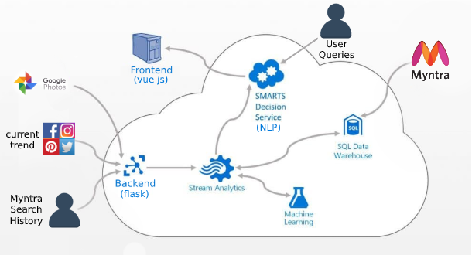
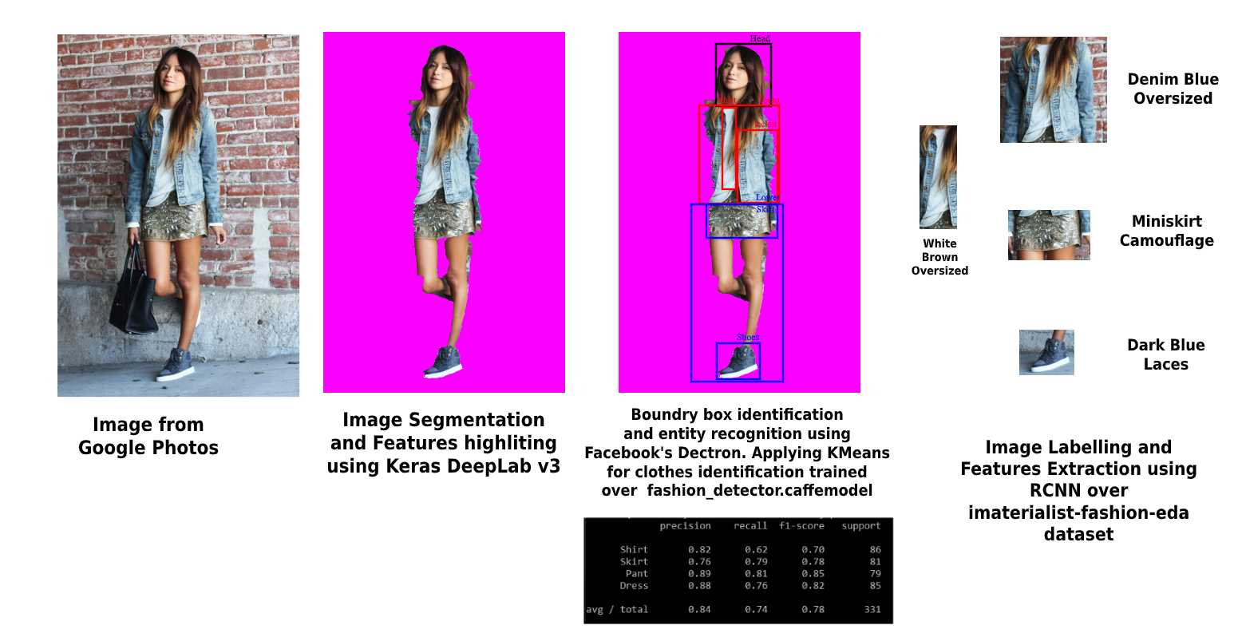
Improved prediction capability by ensembling different data sources
1
Solution
Deep Dive
Easily scalable flask backend, cross-platform capability
2
Identification and feature extraction accuracy of 76.4%
3
Lite weight segmentation allows preprocessing at client side possible hence taking care of data privacy
4
5
Fast RCNN feature extraction takes only 50ms time for computation making the
process super fast.

Slide 5
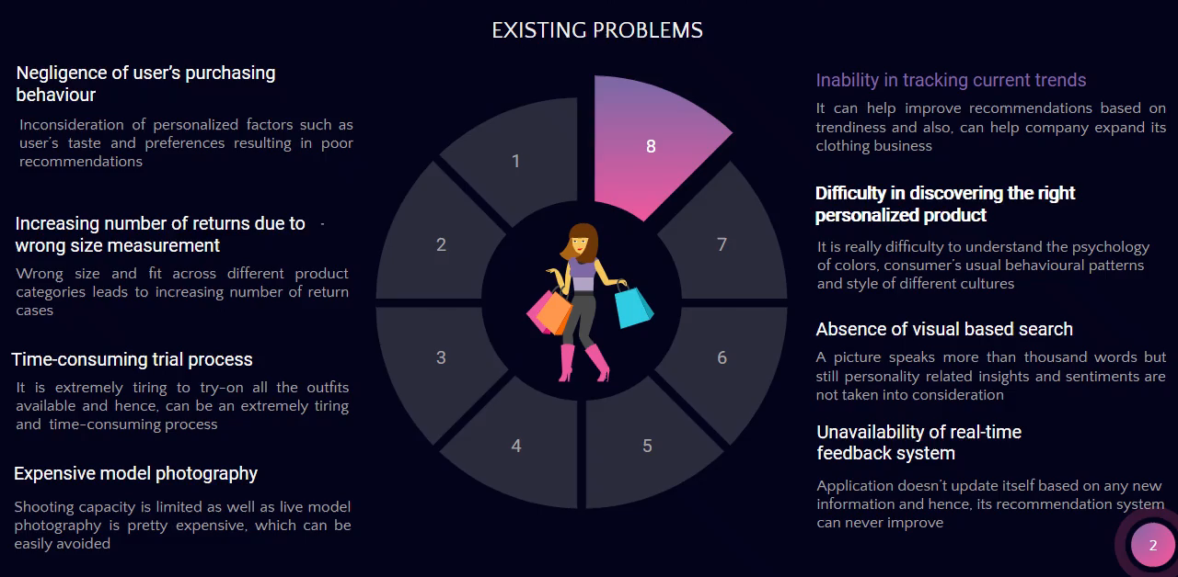
Phase I
DEMO
In case video not working, please visit:
https://youtu.be/m6Hdp1bGRK4

Slide 6
Impact of Our Solution
Benefits and Advantages at both supply and retail end
Clothing Designer
Improvised recommendations
AI Algorithms can analyze designs through images to copy popular styles.
01
06
Users sentiments and style choices can help to know what kind of products they prefer to buy and what they ignore
Improvement via feedback
05
A feedback provided by customer at the end of purchase will help improve our AI stylist. For eg: A comment on an image ‘A bit more formal’ can help AI model provide more context on user’s style choices for future
Trendiness Prediction
Trends Prediction can help see what does and does not sell well in the markets. It will also help customers select a product which is more in trend based on social media channels
02
Virtual try-on
Hassle-free shopping experience
User can try-on the styles and recommendations provided by our A.I stylist to check which clothing attire will suit more on the user’s body. This lets users see how outfits would look on them in reality
03
04
Customers don’t need to choose and have a look at all the clothes present in a store. AI will help them find their top picks instantly and customer can then visualize themselves without any worries regarding wrong size measurement

Slide 7
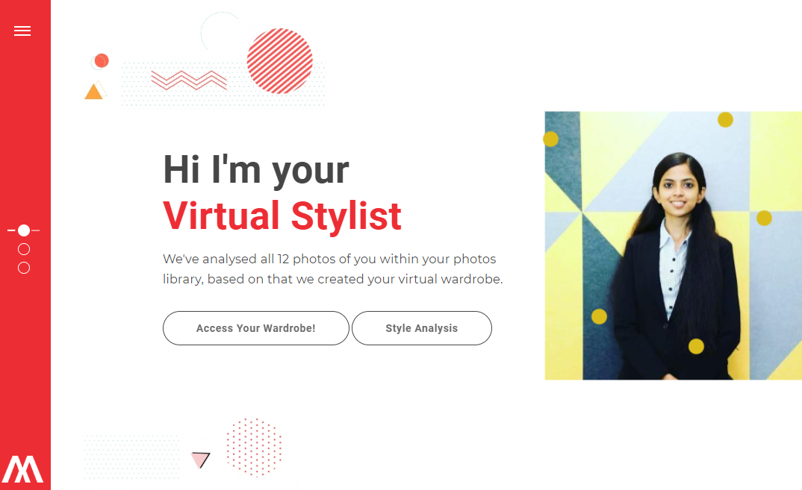
Implementation
Phase - 1
Phase - 2
Cross-platform capability – Mobile & Web App.
Virtual try-on using Apple ARkit and Vuforia SDK.
Ensembling various parameters and using Random Forest Model to enhance prediction accuracy.
Visual search system using Vuforia SDK.
Automated background trend analysis system using web-scraping tools instead of current manual updating system.
Implementing Feedback System using Natural Language Processing (NLP) and Named Entity Recognition (NER)
Improving analysis by using the facial recognition to cluster user in a group photo.
Features implemented till now
Upload user’s images from Google Photos
Identification of user’s personality traits
Recommendations from user’s usual style and
Personalized AI fashion stylist for generating user based clothing

